Slide 1
Linear Algebra
Lecture 34

Slide 2
Linear Algebra
Lecture 34

Slide 3
Eigenvalues and
Eigenvectors

Slide 4
Applications to
Differential
Equations

Slide 5
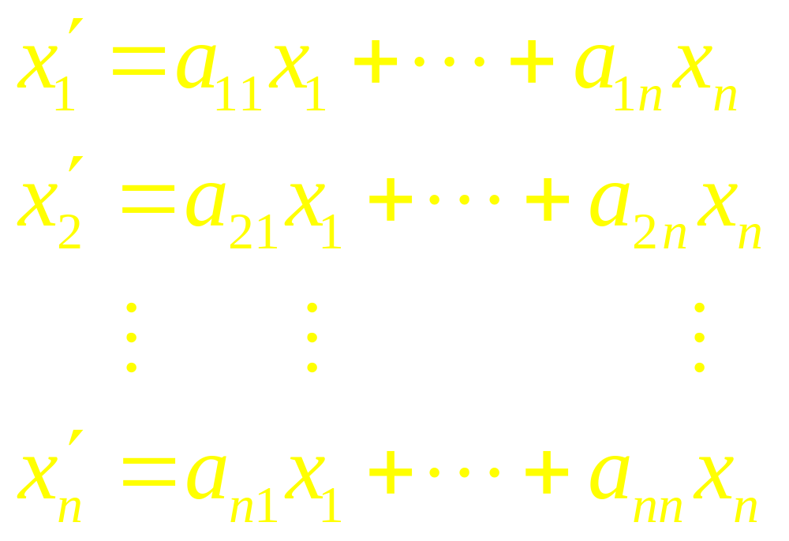
System of Differential
Equations

Slide 6

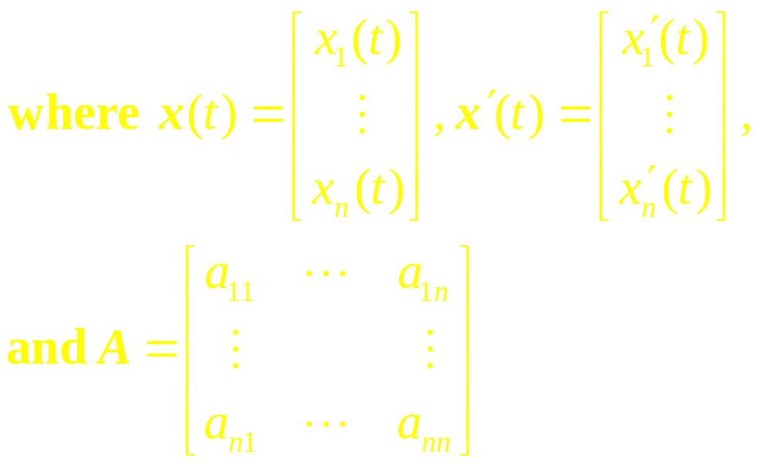
System as a Matrix
Differential Equation

Slide 7

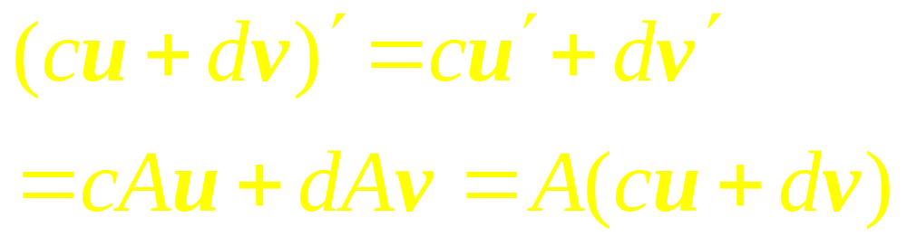
Superposition of
Solutions
If u and v are solutions of
Then cu + dv is also a solution
because

Slide 8
If A is n x n, then there are n linearly independent functions in a Fundamental Set, and each solution of
is a unique linear combination of these n functions.

Slide 9
That is, a Fundamental Set of solutions is a basis for the set of all solutions of

Slide 10
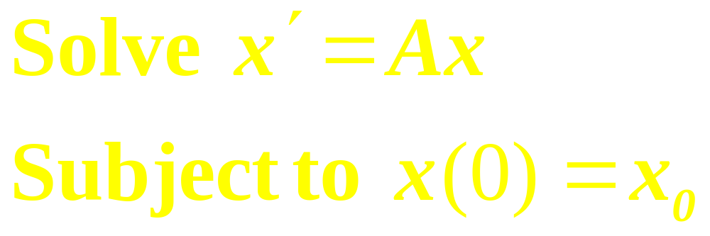
Initial Value Problem

Slide 11
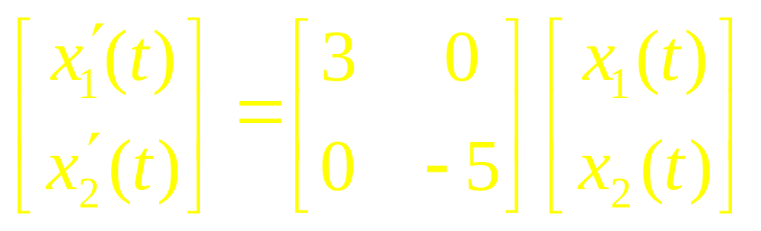
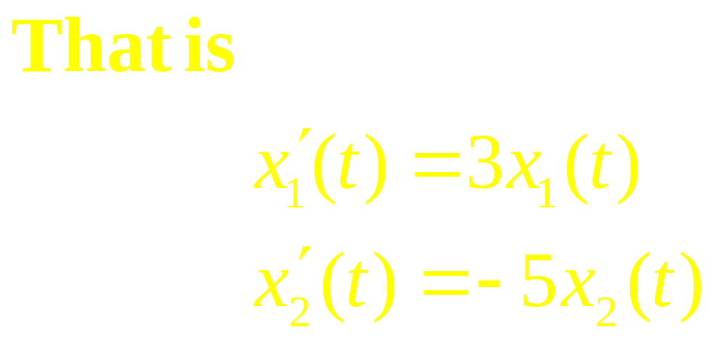
Example
…

Slide 12
continued
The given system is said to be decoupled because each derivative of a function depends only on the function itself, not on some combination or “coupling” of both x₁(t) and x₂(t).
…

Slide 13
continued
The solutions of the equations are x₁(t) = c₁e^{3t} and x₂(t) = c₂e^{-5t}, for any constants c₁ and c₂.

Slide 14
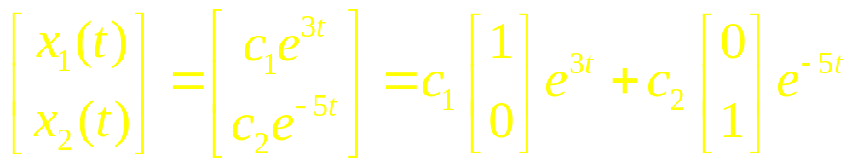
continued
Each solution of given system can be written in the form

Slide 15
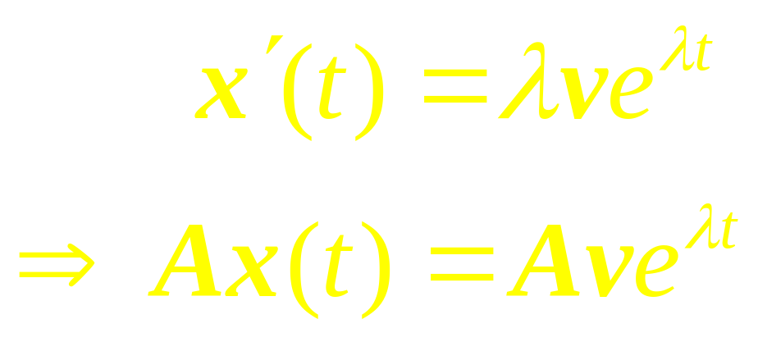
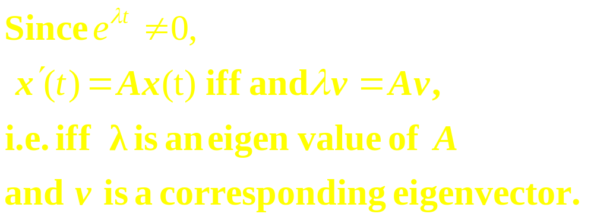
Observe
…

Slide 16
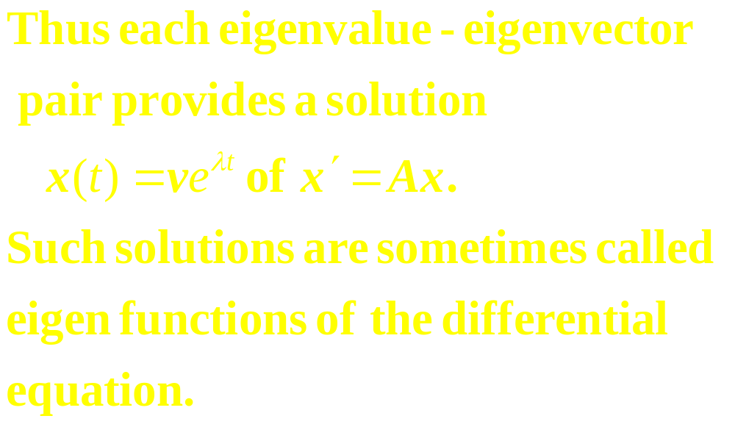

Slide 17
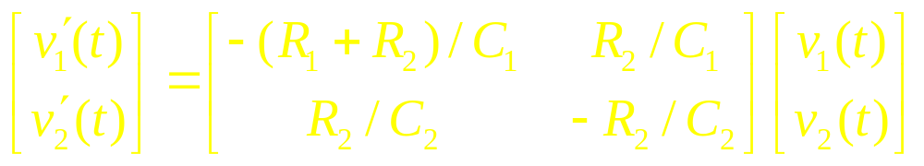
Example 1
The circuit in figure 1 can be described by
where v₁(t) and v₂(t) are the voltages across the two capacitors at time t.
…

Slide 18
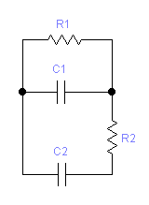
continued
Figure 1
…

Slide 19
continued
Suppose that resistor R₁ is 2 ohms, R₂ is 1 ohms, capacitor C₁ is 2 farads, and capacitor C₂ is 1 farad, and suppose that there is an initial charge of 5 volts on capacitor C₁ and 4 volts on capacitor C₂.
…

Slide 20
continued
Find formulas for v₁(t) and v₂(t) that describe how the voltages change over time.

Slide 21

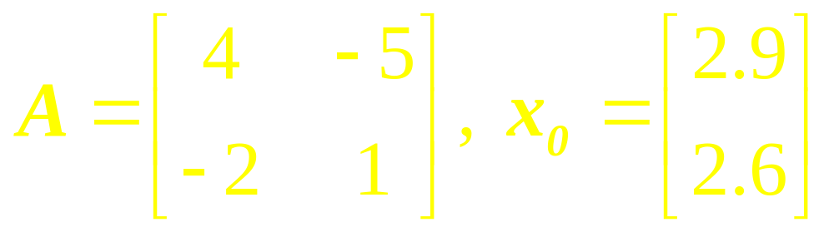
Example 2
Suppose a particle is moving in a planar force field and its position vector x satisfies and x(0) = x₀, where

Slide 22

continued
Solve this initial value problem and sketch the trajectory of the particle,
for

Slide 23
Decoupling a
Dynamical
System

Slide 24
Complex
Eigenvalues

Slide 25
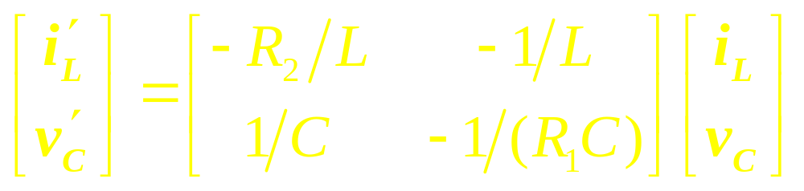
Example 3
The circuit in figure 2 can be described by
…

Slide 26
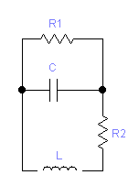
continued
Figure 2
…

Slide 27
continued
where i_{L} is the current passing through the inductor L and v_{c} is the voltage drop across the capacitor C. Suppose R₁ is 5 ohms, R₂ is .8 ohm, C is .1 farad, and L is .4 henry.
…

Slide 28
continued
Find formulas for i_{L} and v_{c}, if the initial current through the inductor is 3 amperes and the initial voltage across the capacitor is 3 volts.

Slide 29
Example 4

Slide 30
Linear Algebra
Lecture 34

Slide 31
Linear Algebra
Lecture 34

